Slide 1

OBJECT-ORIENTED THINKING
CHAPTER 26

Slide 2
Topics
The Object-Oriented Metaphor
Object-Oriented Flocks of Birds
  Boids by Craig W. Reynolds
Modularity

Slide 3
The Object-Oriented Metaphor
Consider Object-Oriented Programming as it relates to a flock of birds
  For hundreds of years, the motions of bird flocks (and schools of fish) fascinated researchers
    How do hundreds of individuals move in such coordinated behavior?
    Which animal "leads" the flock? How is the leader chosen?
  To simulate a flock on a computer in a monolithic way, it was thought that a massive function would be required
    Track every bird's position
    Make global decisions about the behavior of the flock
    Figure out how those global decisions would affect each bird
  But in a real flock, each bird looks at her own environment, goals, etc. and makes decisions
    Each bird acts as an individual based on her understanding of the world
    This is the core concept of Object-Oriented Programming (OOP)

Slide 4
Object-Oriented Flocks of Birds
BOIDS provides another approach to flocks
  "Flocks, Herds, and Schools: A Distributed Behavioral Model" (1987) by Craig W. Reynolds
  A simple, object-oriented approach to flocking behavior that Reynolds called "Boids"
  Boids uses three simple rules:
    Separation
    Alignment
    Cohesion

Slide 5
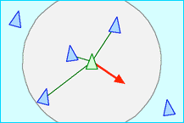
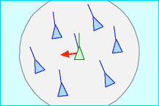
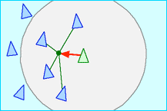
Object-Oriented Flocks of Birds
Boids three rules
    Separation
      Avoid crowding nearby flockmates
    Alignment
      Match heading with nearby flockmates
    Cohesion
      Try to center self relative to nearby flockmates
Images are from Reynold's website http://www.red3d.com/cwr/boids/

Slide 6
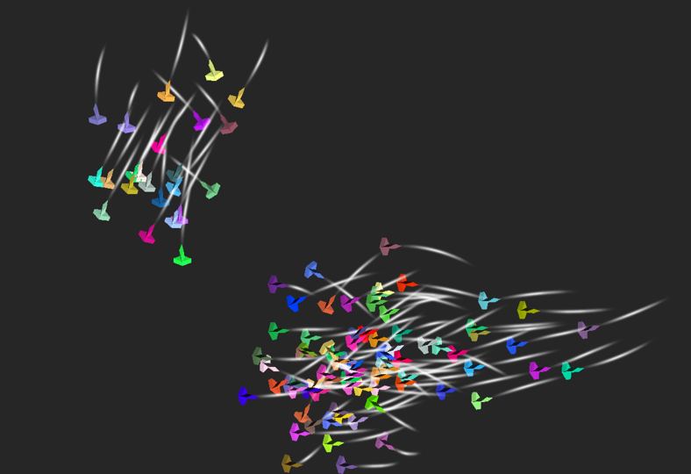
Object-Oriented Flocks of Birds
These three rules create surprisingly good flocking behavior
  https://www.youtube.com/watch?v=86iQiV3-3IA
In this chapter of the book, you create a simple 2D version of Boids that runs in Unity

Slide 7
Modularity
Another aspect of OOP is Modularity
Through modularity, each piece of code is expected to follow specific parameters
  But the internal implementation of that code is up to the individual developer
This enables teams to effectively collaborate on code
  Each programmer receives a spec for what her part of the code is supposed to do
  That code is encapsulated into one or more classes which are clearly documented

Slide 8
Modularity
Collaboration benefits of modular code:
  The public fields and methods of each class are pre-specified
  Other programmers can write code that will interact with each class without knowing the internals implementation of that class
  The internals of the class can be replaced without affecting any other code
However, top-down modularity is often difficult to define ahead of time in game prototypes
  Because the spec for a prototype changes rapidly
  Instead of top-down, just think bottom-up about making your code easily reusable in later projects
  Make each reusable element of your code a module

Slide 9
Chapter 26 – Summary
In OOP, each instance of a class thinks for itself
  Rather than all being controlled by a single function
Through OOP, simple rules can be embedded into each class member
From these simple rules can emerge complex, interesting behaviors
Modular code can help programming teams collaborate
Next Chapter: The Agile Mentality
  Learn about how to approach small-team management
  Learn to use burndown charts and scrum, which have had tremendous success on small, creative group projects

